Slide 1
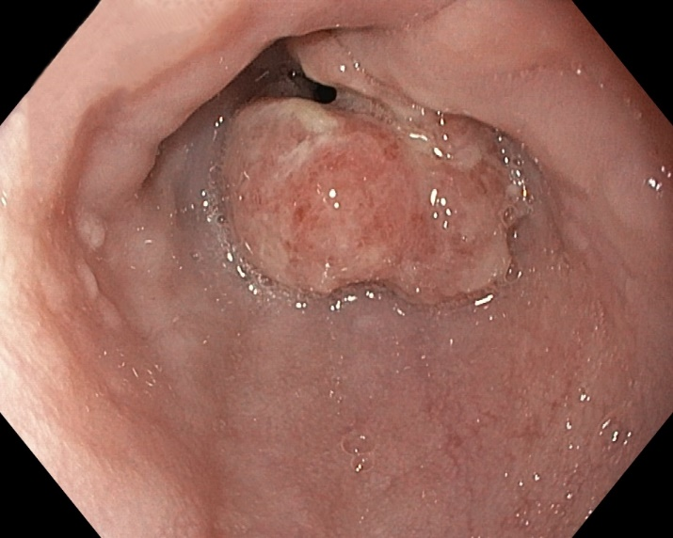
Life expectancy in survivors of esophageal cancer compared to the background population
Ellinor Lundberg, MD, Pernilla Lagergren, PhD, Fredrik Mattsson, BSc, Jesper Lagergren, MD, PhD.
Introduction
It is unknown weather the long-term (>5 years) survival of esophageal cancer survivors differs from the general population.
Aim
The aim was to clarify if and how the survival of patients cured of esophageal cancer differs from that of the corresponding general population
Methods
This cohort study included all patients who survived for at least 5 years after surgery for esophageal cancer in Sweden between 1987-2015, with follow-up throughout 2020. Relative survival rates with 95% confidence intervals (95% CI) were calculated by dividing the observed with the expected survival. The expected survival was assessed from the entire Swedish population of the corresponding age, sex, and calendar year. Yearly relative survival rates were calculated between 6 and 10 years postoperatively. Stratified analyses were performed on various categories including sex and tumour histology. Data of the esophageal cancer group was collected from SESS which is based on various Swedish health data registries and medical records. Data of the background population was derived from Statistics Sweden (SCB).
Results
Table 3. Survival (percentage and 95% confidence intervals) between 6 and 10 years after surgery for esophageal cancer, stratified by tumour histology
Table 1. Survival (percentage and 95% confidence intervals) between 6 and 10 years after surgery for esophageal cancer, all participants
Adenocarcinoma
Year | Number |  | Observed survival | Relative survival
6 7 8 9 10 | 493 416 336 286 243 |  | 94.3 (92.3-96.4) 89.6 (86.8-92.3) 86.1 (82.9-89.3) 84.3 (80.8-87.8) 78.7 (74.6-82.9) | 96.9 (94.8-99.0) 94.4 (91.5-97.3) 93.7 (90.2-97.3) 94.6 (90.7-98.5) 91.5 (86.6-96.3)
Squamous cell carcinoma
Year |  | Number | Observed survival | Relative survival
6 7 8 9 10 |  | 264 232 201 174 145 | 92.4 (89.2-95.6) 84.1 (79.6-88.5) 77.0 (71.7-82.2) 68.6 (62.7-74.4) 63.8 (57.7-70.0) | 94.5 (91.2-97.8) 87.8 (83.1-92.4) 81.9 (76.4-87.5) 74.6 (68.2-80.9) 70.8 (64.0-77.6)
Total
Year | Number | Observed survival | Relative survival
6 7 8 9 10 | 762 653 540 463 391 | 93.7 (92.0-95.4) 87.7 (85.3-90.1) 82.8 (80.0-85.6) 78.3 (75.2-81.5) 73.1 (69.6-76.7) | 96.1 (94.3-97.9) 92.1 (89.6-94.6) 89.4 (86.4-92.4) 86.9 (83.4-90.4) 83.5 (79.5-87.6)
Table 2. Survival (percentage and 95% confidence intervals) between 6 and 10 years after surgery for esophageal cancer, stratified by sex
Men
Year | Number | Observed survival |  | Relative survival
6 7 8 9 10 | 552 466 388 334 274 | 93.3 (91.2-95.4) 86.9 (84.0-89.8) 82.0 (78.6-85.4) 76.8 (73.0-80.6) 70.6 (66.4-74.9) |  | 96.0 (93.8-98.1) 91.8 (88.7-94.8) 89.2 (85.5-92.9) 86.1 (81.8-90.4) 81.8 (76.8-86.8)
Women
Year | Number | Observed survival | Observed survival | Relative survival | Relative survival
6 7 8 9 10 | 210 187 152 129 117 | 94.8 (91.8-97.8) 89.7 (85.5-93.9) 85.0 (79.9-90.1) 82.3 (76.8-87.9) 79.5 (73.5-85.5) | 94.8 (91.8-97.8) 89.7 (85.5-93.9) 85.0 (79.9-90.1) 82.3 (76.8-87.9) 79.5 (73.5-85.5) | 96.4 (93.4-99.5) 93.0 (88.6-97.3) 89.9 (84.5-95.3) 89.0 (83.0-95.0) 88.1 (81.5-94.8) | 96.4 (93.4-99.5) 93.0 (88.6-97.3) 89.9 (84.5-95.3) 89.0 (83.0-95.0) 88.1 (81.5-94.8)
Conclusion:
Esophageal cancer survivors had a decline in survival between 6 and 10 years after surgery compared to the corresponding general population, particularly those with a history of squamous cell carcinoma of the esophagus and male sex.
Karolinska Institutet
Ellinor Lundberg, MD
Molecular Medicine and Surgery (MMK)
ellinorlundberg96@gmail.com

