Slide 1
Osteoporosis medication prescription among individuals with a fragility fracture – Time trends and methodological issues
Stina Ek, MPH, PhD
stina.ek@ki.se

Slide 2
Osteoporosis
Definition: a bone disease that develops when bone mineral density and bone mass decreases → decreased bone strength → increased fracture risk.
Prevalence: - Osteoporosis prevalence among women increases from 2-3% among 50-year-olds to 50% among 80-year-olds.
- Lifetime risk for an osteoporosis/fragility fracture is 50% for women and 25% for men.
Risk factors: Old age, female sex, heredity, poor nutritional intake, decrease of sex hormone levels, lack of physical activity, secondary due to specific medications or diseases.
Review Panel of IOF/Svedbom et al. 2013
Aibar-Almazán et al. 2022
Osteoporosförbundet 2022

Slide 3
Treatment
Swedish guidelines: After a fragility fracture, all postmenopausal women and all men above the age of 50 shall be evaluated for osteoporosis. For more severe fractures (e.g. hip fracture and vertebrae fracture), medications can be prescribed without a bone density test.
Recommended medical treatment (in short):
- Bisphosphonates shall be the first choice of medical treatment, if there are contraindications other antiresorptive medications can be considered.
- Calcium and vit D is not recommended as the only treatment for primary osteoporosis.
However, several sources report undertreatment of osteoporosis medication in terms of secondary fracture prevention
Läkemedelsverket 2020
Socialstyrelsen: Nationella riktlinjer för rörelseorganens sjukdomar 2021
Aibar-Almazán et al. 2022

Slide 4
Aim
While studies suggest undertreatment of osteoporosis after a fragility fracture, population-wide assessments are still scarce. Moreover, knowledge regarding if and how osteoporosis medication is prescribed to a similar extent in population subgroups is needed.
Therefore, with this study we aimed to investigate and describe medical osteoporosis treatment as secondary fracture prevention in the Swedish older population. Specifically, we examine how prescription has changed over time, and the extent that prescriptions were different in men and women, between age groups and by level of education.
Jonsson et al. 2015
Abrahamsen et al. 2019
Åkesson et al. 2021 & 2022
Kulbay et al. 2921

Slide 5
Methods
Study population: Individuals from 70 years and above with a fragility fracture within 5 years.
Sources: the National patient register, the Cause of death register, the LISA register and the Prescribed drugs register.
Time period: 2007-2020
Definition of fragility fracture: humerus, (S42.2–S42.4), lower forearm (S52.5 and S52.6); hip (S72.0–S72.2), or vertebral (S12, S22.0, S22.1, S32.0 and T08)
Definition of osteoporosis medication: Bisphosphonates, Denosumab, Strontium ranelate and Parathyroid hormones
(Alt: Estrogens, Vitamin D and
Calcium)
The Ageing and Health Cohort: https://ki.se/en/imm/the-ageing-population
Wändell et al. 2021
Notes:
the Longitudinal integrated database for health insurance and labour market studies

Slide 6
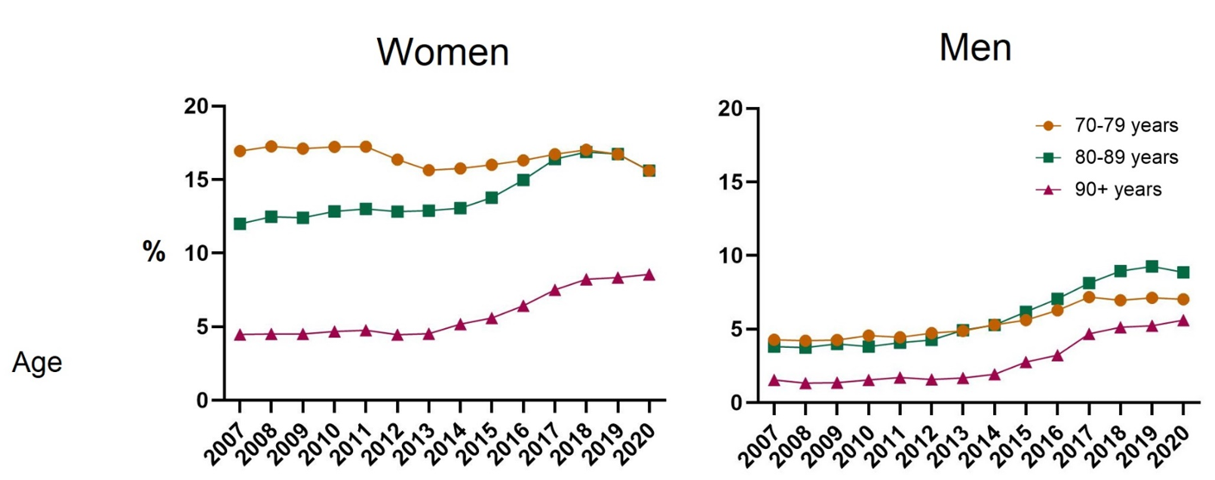
Results
Time trends
17-10%
 | Women (n=210,113) | Men (n=84,219)
Age, in years
70-79 | Ref. | Ref.
80-89 | 0.75 (0.73-0.77) | 0.94 (0.88-0.99)
90+ | 0.29 (0.28-0.30) | 0.46 (0.41-0.51)
Living alone | Ref. | Ref.
Living with someone | 1.16 (1.13-1.19) | 1.17 (1.11-1.24)
Education
Primary | Ref. | Ref.
Secondary | 1.10 (1.07-1.14) | 1.05 (0.99-1.12)
University | 1.18 (1.14-1.22) | 1.07 (0.99-1.15)
Sociodemographic factors associated to prescription
references
Notes:
(as you can see it is also decreasing during the pandemic year, but that is another discussion)

Slide 7
Prescription proportions are low despite clear benefits and guidelines… How come?

Slide 8
Issue 1
Treatment with calcium and/or vitamin D considered sufficient by health care professionals?
Prescription before and after a fragility fracture
references

Slide 9
Issue II
Medications given on requisition
- handed out directly at hospitals, primary care and care homes
especially in the form of injections
requisition data only available on aggregated level, no individual data
eHälsomyndigheten
Notes:
Not all types of medications, but osteoporosis medication is one of them…

Slide 10
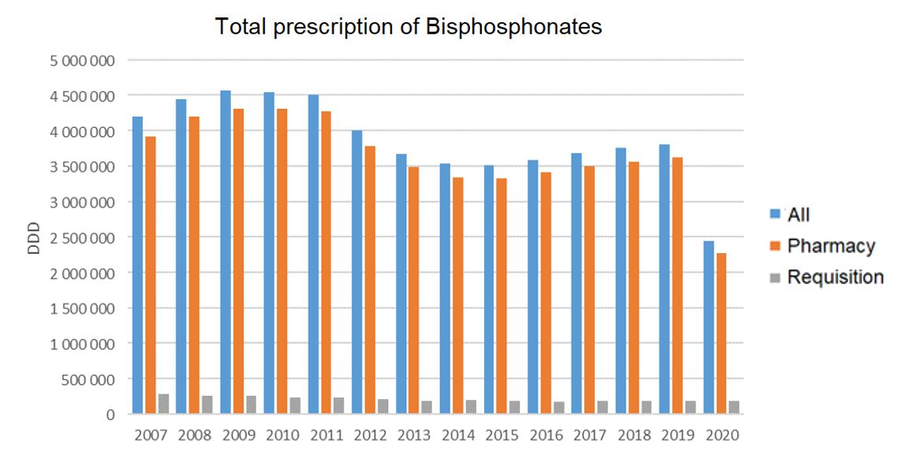
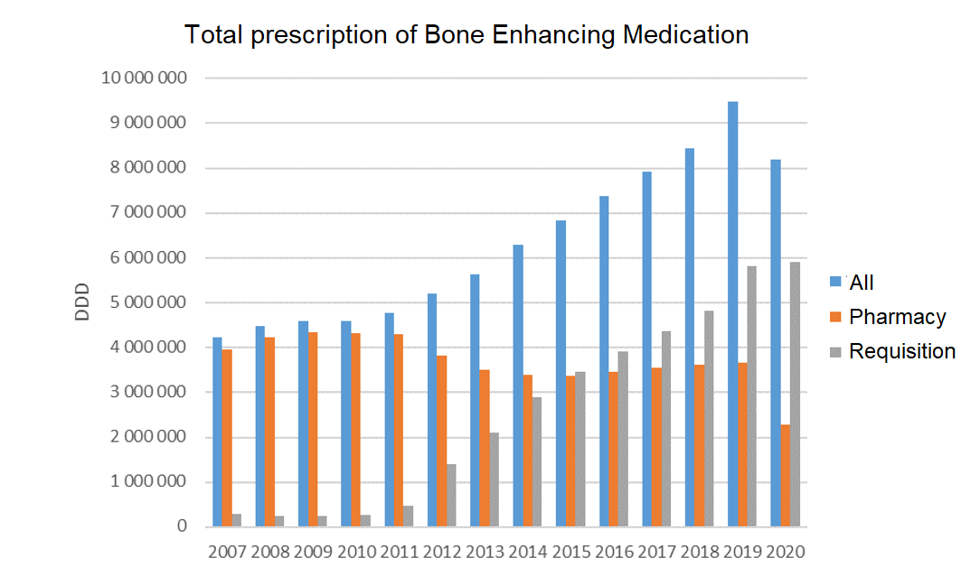
Osteoporosis medications on requisition
Note!
The whole Swedish population, all ages
These medication are also given for hypercalcemia in cancer patients
references
Notes:
Defined daily dose. So these numbers are not comparable to our study population and are not all medications for osteoporis, but it shows that there are sources of medication that we miss and that this source seem to increase over time .

Slide 11
Conclusion
It is not possible to know the exact prescription proportion on an individual level, due to multiple sources…
Regardless, the prescription proportion is too low and does not adhere to the national guidelines.
Fracture Liaison Services (FLS) (frakturkedjor) is proven to be effective as secondary fracture prevention → room for improvement
Next step: Regional differences in osteoporosis medication prescription
Notes:
BUT it is difficult to put pressure on decision makers without access to all data…

Slide 12
Thank you:
Co-authors:
Anna Meyer
Margareta Hedström
Maria Sääf
Karin Modig
Funders:
Kamprad Foundation
Forte
Familjen Krook
stina.ek@ki.se

Slide 13
Type |  | ATC code
Vitamin D/Calcium |  | A12AA02, A12AA04, A12AA06, A12AX, A11CC05
Estrogens |  | G03CA03 (except for vaginal use: Vagidonna, Vagirux, Vagifem, Oestring) , G03CX01, G03FA01, G03FA12, G03FA15, G03FA17, G03FB05, G03FB06, G03FB09
Osteoporosis medications | Parathyroid hormones | H05AA02, H05AA03
 | Bisphosphonates | M05BA01, M05BA04, M05BA07, M05BA08, M05BB01, M05BB02, M05BB03, M05BB05
 | Strontium ranelate | M05BX03
 | Denosumab | M05BX04
[MH1]Ta bort prep namn?

