Slide 1
Disentangling the multigenerational transmissions of socioeconomic disadvantages and mental health problems by gender and across lineages: Findings from the Stockholm Birth Cohort Multigenerational Study
Baojing Li, PhD student
Department of Public Health Sciences, Stockholm University
Supervisors: Lisa Berg, Ylva Brännström Almquist, Can Liu

Slide 2
Content
Aim and research questions
Methods
Results

Slide 3
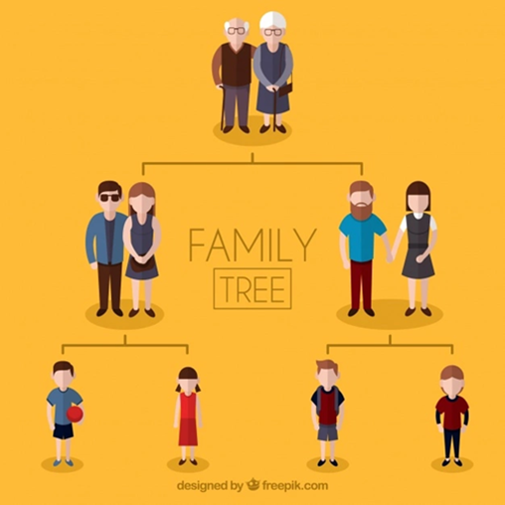
Aim and research questions

Slide 4
Aims and research questions
Aim
To disentangle the complexity through which socioeconomic disadvantages (operationalized as low income) and mental health problems (operationalized as psychiatric disorders) may be jointly transmitted across three generations of Swedish men and women.
Research questions
To what extent are low income and psychiatric disorders, respectively, transmitted across three generations (i.e., grandparents, parents, and grandchildren)?
In what way, if any, does the multigenerational transmission of psychiatric disorders matter for the multigenerational transmission of low income?
In what way, if any, does the multigenerational transmission of low income matter for the multigenerational transmission of psychiatric disorders?
Do these above-mentioned transmissions differ by lineage and grandchild gender?

Slide 5
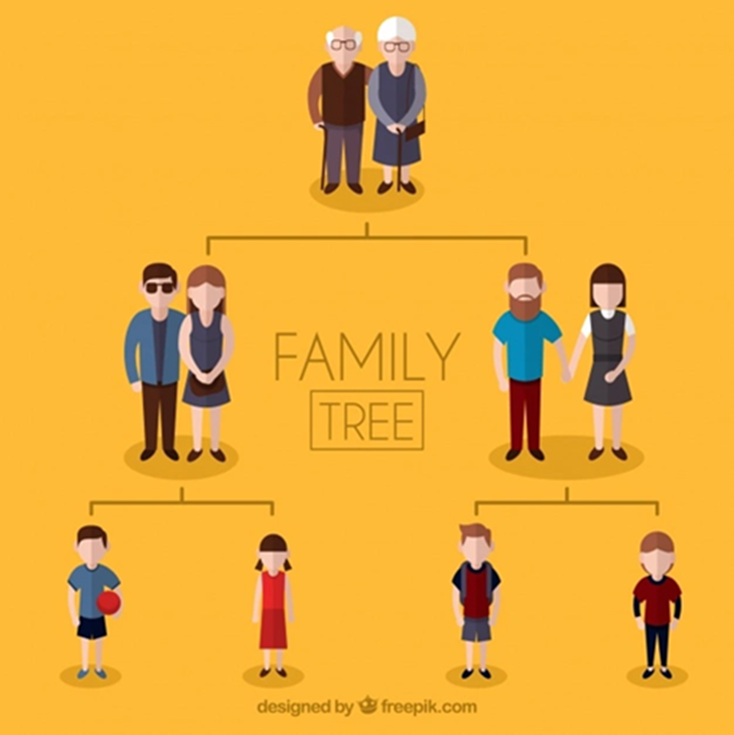
Concurrent association of socioeconomic conditions and mental health
The intragenerational association
The intergenerational association
Mental health problems matter for transmission of socioeconomic disadvantages
Socioeconomic disadvantages matter for transmission of mental health problems
The multigenerational association
Gap: simultaneously investigating transmissions of socioeconomic disadvantages and mental health problems in a multigenerational framework
Gap: addressing the issue of gender differences (life courses being gendered)

Slide 6
Methods

Slide 7
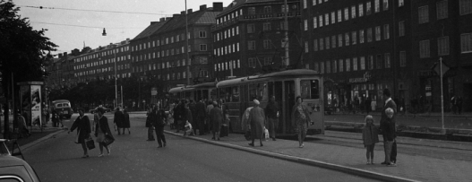
Data sources
Stockholm Metropolitan Study (SMS)
Individuals born in 1953 who resided in the greater Stockholm metropolitan area in 1963 (n = 15,117)
1953 up until the mid-1980s
Probability matching
THE STOCKHOLM BIRTH COHORT MULTIGENERATIONAL STUDY (SBC MULTIGEN)
Individuals born in 1953 who resided in the greater Stockholm metropolitan area in 1963 (G1) , as well as their parents’(G0) and children’s (G2) generation (n=14,608)
RELINK53
Individuals born in 1953 who lived in Sweden in 1960, 1965 and/or 1968, as well as their parents’ and children’s generation (n = 2,390,753)
1960s up until today

Slide 8
Analytical sample
G1
(Total: n=14,608;
Men: n=7,447;
Women: n=7,161)
The multigenerational data structure
Had at least one child
G0
(Total: n=11,338;
Men: n=11,338;
Women: n=11,338)
G1
(Total: n=11,338;
Men: n=5,540;
Women: n=5,798)
G2
(Total: n=24,929;
Men: n=12,848;
Women: n=12,081)

Slide 9
Analytical sample
G2
(Total: n=24,929;
Men: n=12,848;
Women: n=12,081)
Inclusion criteria
Information on income between ages 25-30 during the period 1990-2015
G2
(Total: n=20,904;
Men: n=10,764
Women: n=10,140)
Alive during follow-up of psychiatric disorders (i.e., until three years after income was measured)
G2
(Total: n=20,844;
Men: n=10,723
Women: n=10,121)
Information on income and psychiatric disorders in G0 and G1 + G1 alive during follow-up of psychiatric disorders in G1
G2
(Total: n=20,589;
Men: n=10,609
Women: n= 9,980)

Slide 10
Analytical sample
G0
(Total: n=10,341;
Men: n=10,341;
Women: n=10,341)
G1
(Total: n=10,341; Men: n=4,908;
Women: n=5,433)
G2
(Total: n=20,589; Men: n=10,609
Women: n= 9,980)
The multigenerational structure of the analytical sample
Patriline-G2 Men
(n=5,087)
Patriline-G2 Women
(n=4,798)
Matriline-G2 Men
(n=5,952)
Matriline-G2 Women
(n=5,579)

Slide 11
Variables and statistical analysis
Low income
Low income
Low income
Psychiatric disorders
Psychiatric disorders
Psychiatric disorders
Earned income 1963
Dependency and Child Welfare Committee data (1953 – 59; 1960 – 65)
Gross income at age 37
Records of inpatient care with a main or contributing diagnosis
Gross income at age 30
Records of inpatient care with a main or contributing diagnosis
gross income at age 37
stepwise path models
Notes:
figures

Slide 12
Results

Slide 13
Results
Low income is transmitted across the patriline.
Multigenerational transmission of psychiatric disorders among grandsons.
Note: Covariates are omitted from the figure. Presented estimates are exponentiated coefficients (odds ratios) for patriline-G2 men/patriline-G2 women/matriline-G2 men/matriline-G2 women in each path. LI: Low Income, PD: Psychiatric Disorders. n.s.: not significant; * p<0.05; ** p<0.01.
Notes:
future

Slide 14
Results
Grandparents’ psychiatric disorders are associated with their children’s and grandchildren’s income.
Note: Covariates are omitted from the figure. Presented estimates are exponentiated coefficients (odds ratios) for patriline-G2 men/patriline-G2 women/matriline-G2 men/matriline-G2 women in each path. LI: Low Income, PD: Psychiatric Disorders. n.s.: not significant; * p<0.05; ** p<0.01.
Notes:
future

Slide 15
Results
Low income plays a role for the multigenerational transmission of psychiatric disorders among grandsons.
Note: Covariates are omitted from the figure. Presented estimates are exponentiated coefficients (odds ratios) for patriline-G2 men/patriline-G2 women/matriline-G2 men/matriline-G2 women in each path. LI: Low Income, PD: Psychiatric Disorders. n.s.: not significant; * p<0.05; ** p<0.01.
Notes:
future

Slide 16
Take-home messages
Multigenerational transmissions of socioeconomic disadvantages and mental health problems are differed by lineage and grandchild gender.
Grandparents’ mental health problems could cast a long shadow on their children’s and grandchildren’s socioeconomic outcomes.
Socioeconomic disadvantages in the intermediate generation may play an important role for the multigenerational transmission of mental health problems.

Slide 17
Thank you!

