Slide 1
Overweight, Obesity and Venous Thromboembolism in Young Women
Annika Rosengren, MD, professor
Ahmad Mahmoud, Bachelor of Medicine
Department of Molecular and Clinical Medicine
Sahlgrenska Academy
University of Gothenburg

Slide 2
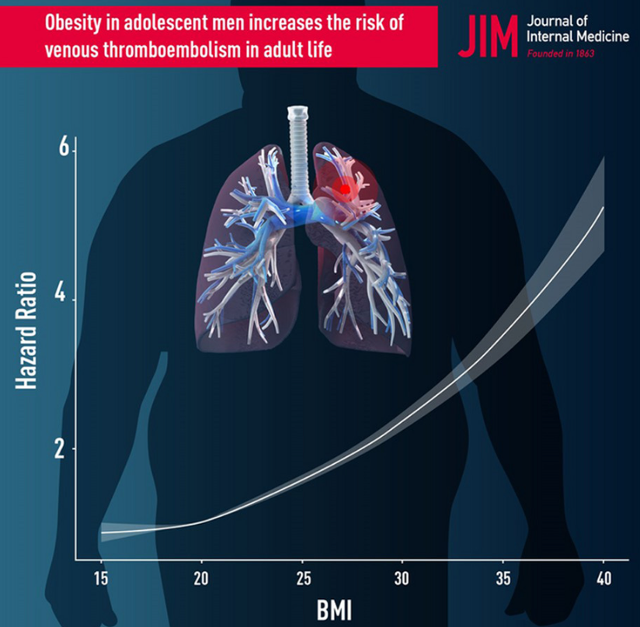
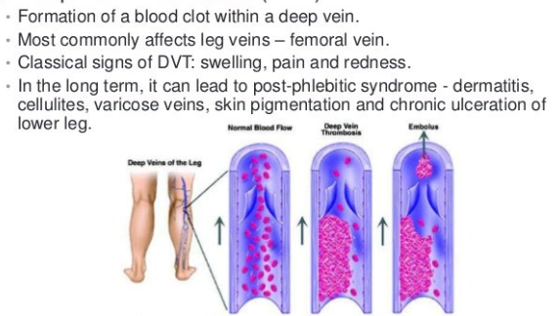
What is venous thromboembolism and why is this important?
Venous thromboembolism (VTE), a term referring to blood clots in the veins, is an underdiagnosed and serious, yet preventable medical condition that can cause disability and death.
A blood clot formed in the leg can move to the lung and can cause serious symptoms, interfering with lung function and can be immediately fatal

Slide 3
VTE includes deep vein thrombosis (DVT) and pulmonary embolism (PE).
Risk factors: major injury, surgery, immobility, cancer, inflammation
In under 65s more common than acute myocardial infarction (AMI)
2019: AMI 4940, PE 3762, DVT 6411
Obesity is considered to be a weak risk factor

Slide 4
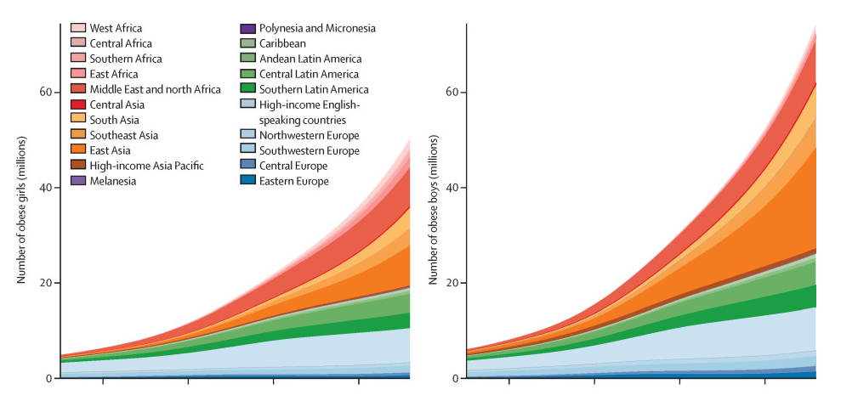
Children and adolescents in the world with obesity 1975-2016
Girls
Boys
NCD Risk Factor Collaboration (NCD-RisC). Lancet. 2017 Dec 16;390:2627-2642.
Notes:
The number of girls with obesity increased from 5 (95% CrI 1–14) million in 1975 to 50 (24–89) million in 2016. The number of boys with obesity increased from 6 (1–19) million in 1975 to 74 (39–125) million in 2016. 73% of the increase in the number of children and adolescents with obesity was due to increase in prevalence of obesity, 3% due to population growth and changes in age structure of the child and adolescent population, and another 24% due to the interaction of the two

Slide 5
Proportion (%) young women in the Medical Birth Registry with BMI > 30 and BMI > 35, 1981-2015.
Lundberg CE, et al. Sci Rep 2021;11:12056

Slide 6
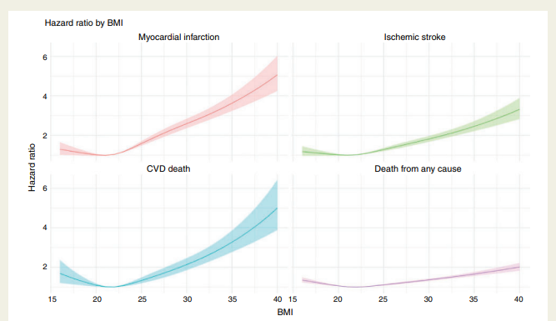
BMI in the first trimester (1,5 mill., average 29 years) and adjusted risk for death and CVD outcomes
Dikaiou P, et al. Eur J Prev Cardiol 2021;28:1351-9.
Notes:
We included 1 522 480 women who had their weights and heights recorded during early pregnancy with a baseline median age of 28.3 (standard deviation [SD] ±5.1) years. Over a median follow-up of 16.5 years (interquartile range 7.8-25.8 years), we identified 3 583, 4 656, 1 517 and 2 112 cases of AMI, IS, HS and SAH, respectively,

Slide 7
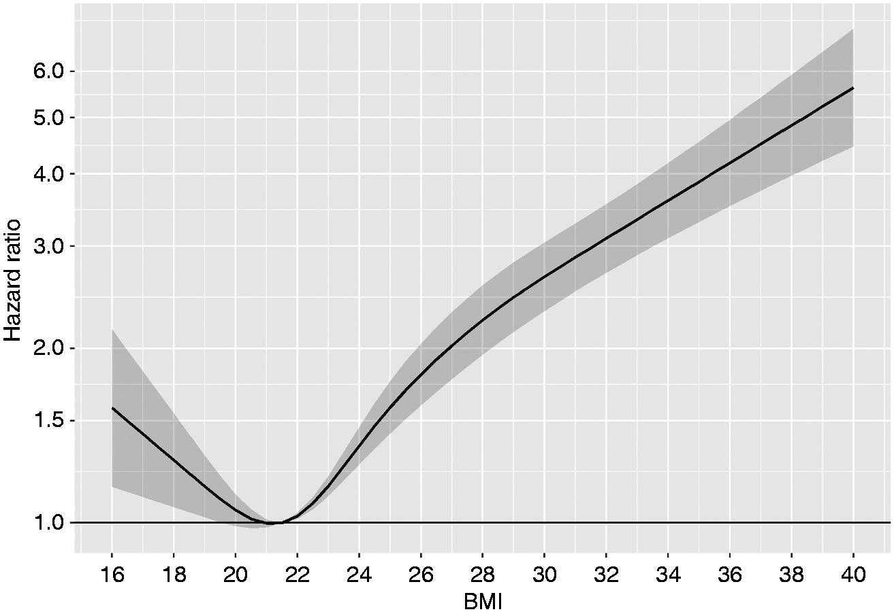
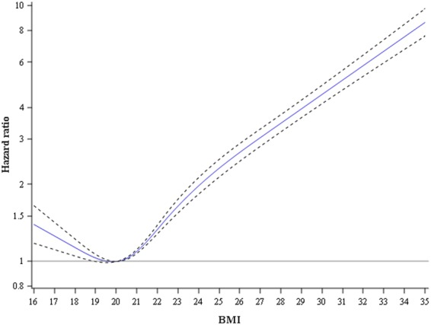
Association between BMI when young (men 18, women of childbearing age) and risk of heart failure
Women in the MBR, mean age 29
Men in the conscript registry,
mean age 18
Björck L, et al. Eur J Prev Cardiol. 2020;27:1165-1174.
Rosengren A, et al. Eur Heart J. 2017 21;38:1926-33.

Slide 8
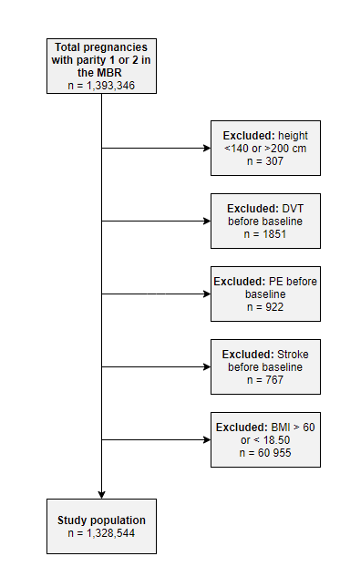
Study aims and population
Aim: to determine the association between BMI and early VTE (DVT and/or PE) in women
The Swedish Medical Birth Registry (MBR) was used to identify all women in Sweden aged between 18 and 45 years who gave birth to their first child 820101-141231.
Women were included in the study at the date of their first antenatal visit, usually between 6 and 12 weeks of gestation (90% of women).

Slide 9
Baseline characteristics of the study population
Variable | All
n | 1,328,544
Age, years (±SD) | 27.8 ± 4.90
BMI, mean (±SD) | 23.71 ± 3.90
Hypertension, n (%) | 1456 (0.1)
Diabetes, n (%) | 6596 (0.5)
Smoking n (%), cigarettes/day
0 | 1108783 (85.5)
1-9 | 129342 (10.0)
≥ 10 | 58407 (4.5)
Education, n (%)
≤ 9 years | 170208 (12.9)
10–12 years | 624289 (47.2)
>12 years | 519642 (39.2)

Slide 10
Event rates by BMI categories Median follow-up duration of 15 years (interquartile range, 7–23 years)
Variable | All | 15 ≤ BMI < 18.5 | 18.5≤ BMI <20 | 20≤ BMI <22.5 | 22.5≤ BMI <25 | 25≤ BMI <27.5 | 27.5 ≤ BMI <30 | 30≤ BMI <35 | 35≤ BMI <60 | p
n | 1 088 214 | 43987 | 120174 | 350422 | 281404 | 144039 | 70151 | 57291 | 20746
Venous thromboembolism (VTE)
Crude events | 4015 | 181 | 414 | 1170 | 1008 | 560 | 305 | 267 | 110 | <0.001
Event rate per 100 000 years (95% CI) | 24.8 | 21.9 | 19.5 | 20.8 | 25.1 | 29.8 | 35.6 | 42.0 | 55.7 | <0.001
Pulmonary embolism (PE)
Crude events | 2562 | 108 | 266 | 758 | 645 | 342 | 204 | 168 | 71 | <0.001
Event rate per 100 000 years (95% CI) | 15.8 | 13.0 | 12.5 | 13.5 | 16.0 | 18.2 | 23.8 | 26.4 | 35.9 | <0.001
Deep venous Thrombosis (DVT)
Crude events | 1776 | 83 | 179 | 510 | 439 | 262 | 127 | 128 | 48 | <0.001
Event rate per 100 000 years (95% CI) | 11.0 | 10.0 | 8.4 | 9.1 | 10.9 | 13.9 | 14.8 | 20.1 | 24.3 | <0.001

Slide 11
Final model for VTE after adjustment
BMI category (kg/m²) | Adjusted HR VTE
18.50 -< 22.5 | 0.80 (0.75-0.85)
20 -< 22.5 (referens) | 1
22.5 -< 25 | 1.23 (1.18-1.29)
25 -< 27.5 | 1.62 (1.58-1.79)
27.5 -< 30 | 1.97 (1.82-2.13)
30 -< 35 | 2.59 (2.39-2.81)
35 -< 60 | 4.13 (3.68-4.43)
Adjusted for:
Age
Calendar year
Parity
Hypertension
Diabetes
Smoking
Education

Slide 12
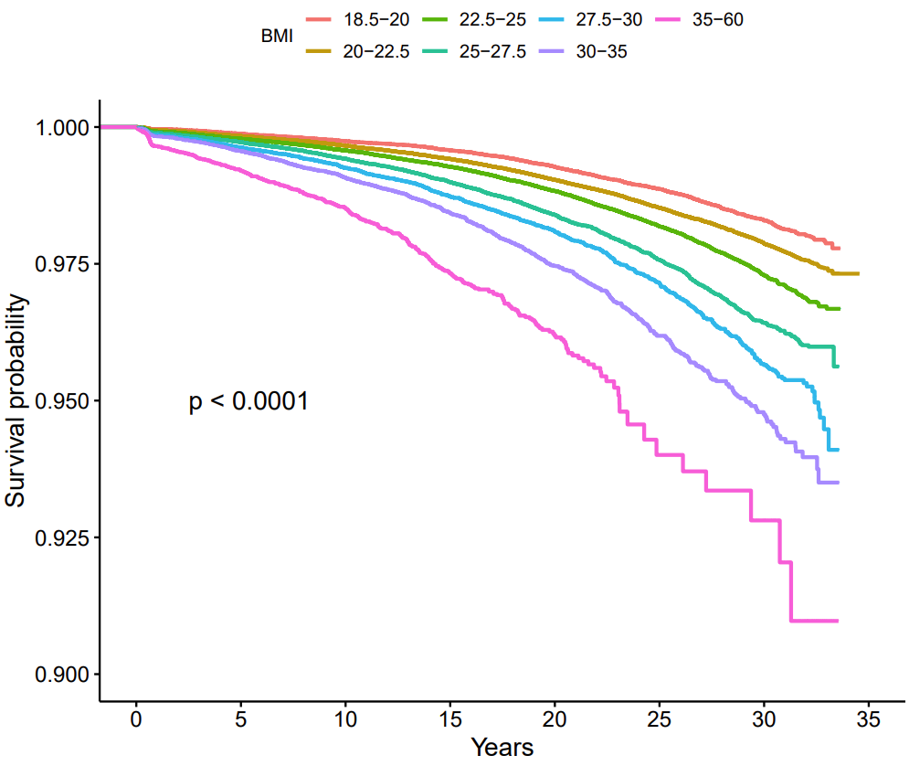
Kaplan-Meier plot for VTE

Slide 13
Conclusions and implications for the future
Overweight and obesity at a young age: risk factor for early VTE in women
Visible increase in risk at high-normal BMI (22.5-<25 kg/m²)
4-fold increase in risk among the very obese (BMI 35 and over)
Obesity rising rapidly among the young = many cardiometabolic disorders (including VTE) associated with high age will be seen more frequently among young obese people.

