Slide 1
Swedish Register-Based Research Summit presentation The returns to returning – Economic returns to remigration to Finland
Weiqian Xia^{1, 2, 3}, Jani Turunen¹, Jan Saarela³, Siddartha Aradhya^{1, 2}
¹ Södertörn University, ² Stockholm University, ³ Åbo Akademi University

Slide 2
Returns of (return) migration
Research on costs and returns of (re)migration (Borjas 1987; Constant & Massey 2003; Dustmann et al. 2011)
Human capital model
Migrate for accumulating wealth & skills; benefit to possible return
Experience & adaptation abroad
Difficulty for causally identifying the return of (re)migration
Counterfactual: what if not migrated?
Selection based on unmeasured individual, family, etc. characteristics
Possible solution: sibling comparison (Sjölander et al. 2022)
Previously done in the case of Norwegian migrants in US (Abramitzky et al. 2012; 2019)

Slide 3
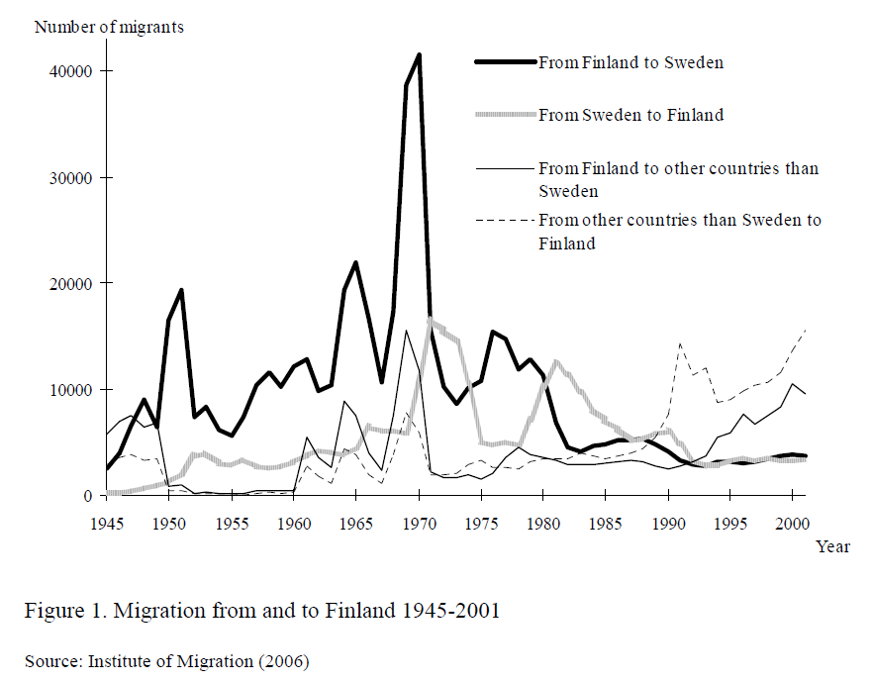
Migration from & to Finland
Large migration flow from Finland (majorly to Sweden) after 1950s, peaking in 1970s
Every second of them return in three years (Saarela & Finnäs 2009)
Return migrants have substantially worse labor market performance in employment and income (Saarela 2015; Saarela & Finnäs 2009)
Selection of “best of the worst” (Rooth & Saarela 2007)
Newer counterevidence (Koikkalainen et al. 2016)
Study aim: sibling comparison as strict controls

Slide 4
Data & analytical approach
Register data from Statistics Finland
Annual1987-2019 (also quinquennial 1970-1985)
Labor market outcomes: 2 years after return
Logged income (earned + entrepreneurial)
Employment & inactivity level; employment rate (those in labor market)
Sibling fixed-effect
Return migrants; migrated over age 18 & stayed abroad for at least 2 years
Non-migrant siblings with the same sex
Birth cohorts 1953-2001
Controls: Age group, mother tongue, period, education, family composition
Individual-year observations 1987-2019
 | Men | Women | Total
Non migrants | 10378 | 11697 | 22075
 | 58.13% | 57.79% | 57.95%
Return migrants | 7476 | 8543 | 16019
 | 41.87% | 42.21% | 42.05%

Slide 5
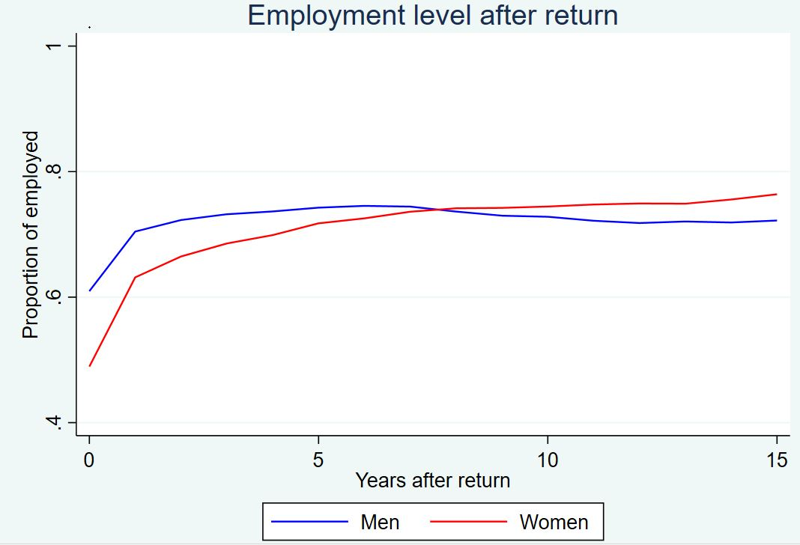
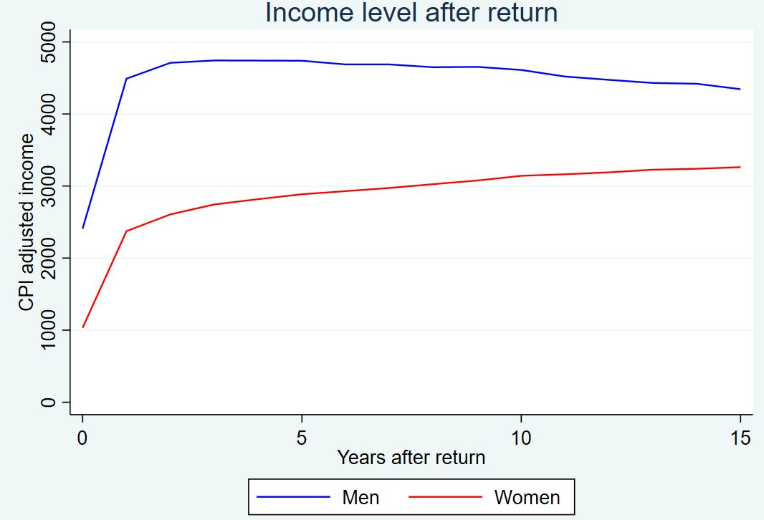
Descriptive findings
Return migrants have low employment & income levels; recovering over time
Worse for women & who stay longer abroad

Slide 6
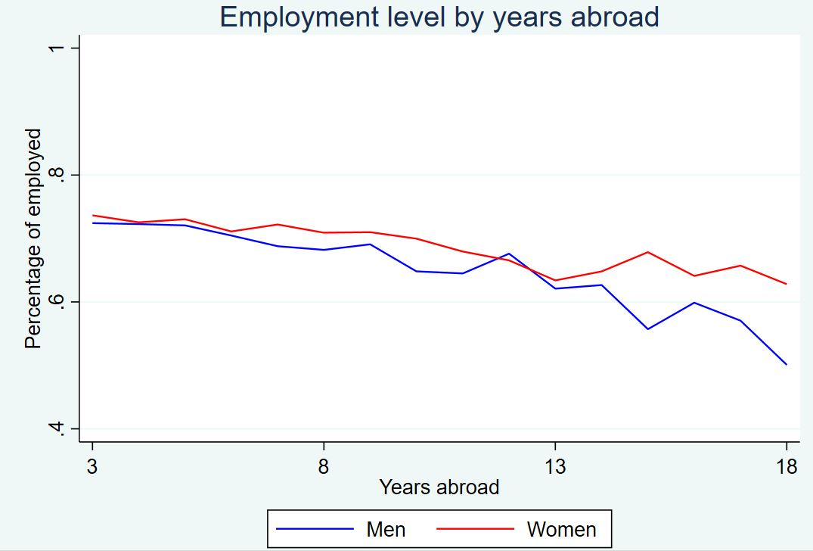
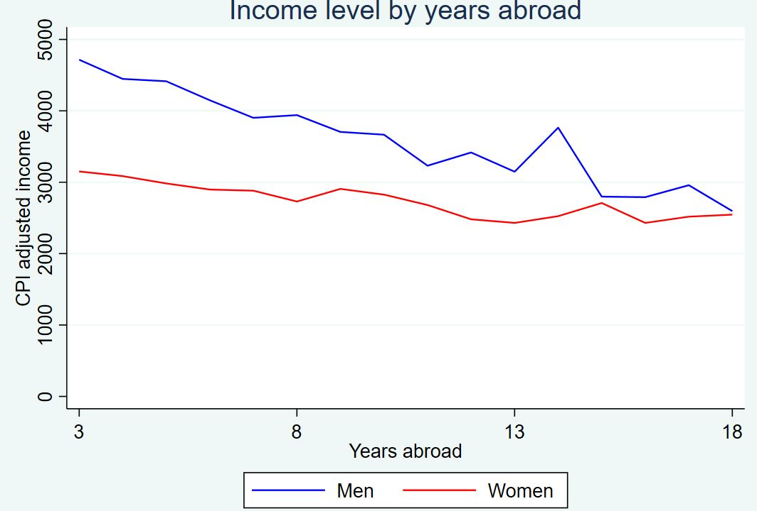
Descriptive findings
Return migrants have low employment & income levels; recovering over time
Worse for women & who stay longer abroad

Slide 7
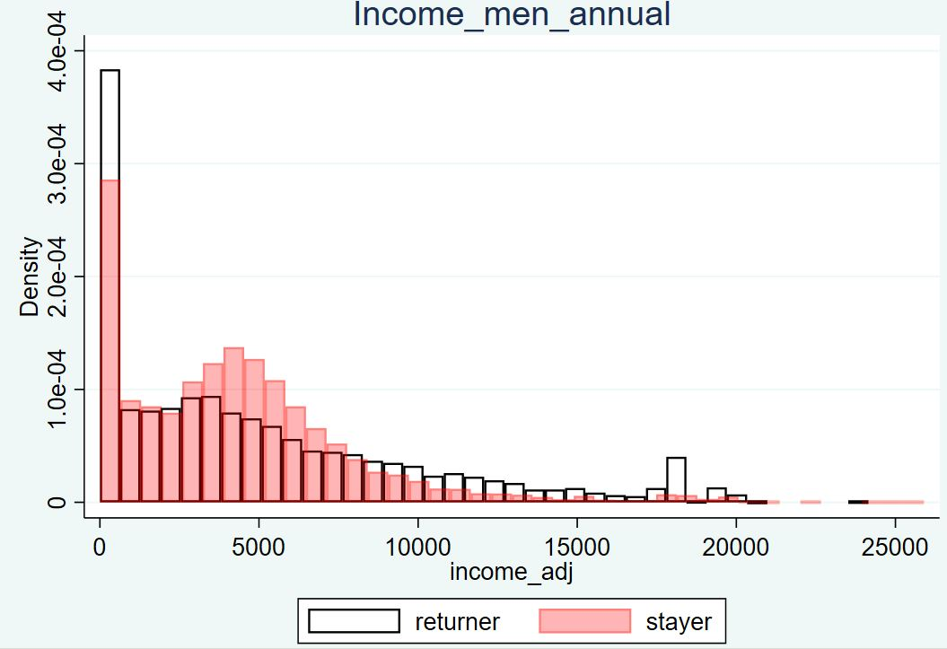
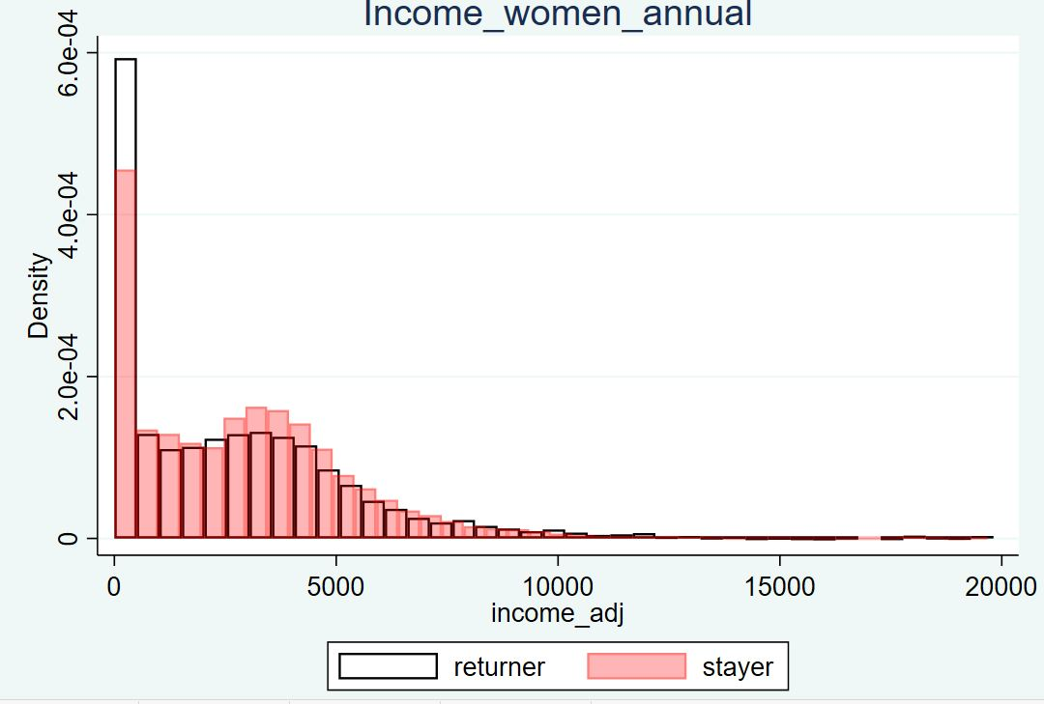
Descriptive findings
Return migrants have low employment & income levels; recovering over time
Worse for women & who stay longer abroad

Slide 8
Modeling findings
Modelling results: annual data 1987-2019 (SFE: sibling fixed-effect)
Men |  | Women
No SFE | SFE | No SFE | SFE
Level of employment
N = 17950 |  | N = 20559
-0.067*** | -0.067*** | -0.086*** | -0.081***
(0.006) | (0.006) | (0.006) | (0.006)
Logged income
N = 17950 |  | N = 20559
-0.473*** | -0.460*** | -0.652*** | -0.603***
(0.042) | (0.042) | (0.041) | (0.420)
Risk of inactivity
N = 17950 |  | N = 20559
0.032*** | 0.033*** | 0.066*** | 0.063***
(0.005) | (0.005) | (0.006) | (0.006)
Rate of employment for those in labor market
N = 15589 |  | N = 16307
-0.045*** | -0.045*** | -0.034*** | -0.032***
(0.006) | (0.005) | (0.005) | (0.005)
***: p<0.001; **: p<0.01; *: p<0.05; Standard errors in parentheses.
Return migrants have disadvantages in income, employment (rate) and labor market participation
Income disadvantage strong for non-tertiary educated
Consistent after controlling for sibling fixed-effect
Robust: quinquennial data 1975-2015; outcome measured after 5 years; only working ages (26-55) individuals

Slide 9
Modeling findings
Modelling results: annual data 1987-2019 (SFE: sibling fixed-effect)
Men |  | Women
No SFE | SFE | No SFE | SFE
Logged income for the employed
N = 13541 |  | N = 14662
-0.045 | -0.062* | -0.094*** | -0.100***
(0.027) | (0.025) | (0.026) | (0.023)
Logged income for non-tertiary-educated
N = 11020 |  | N = 10735
-0.404*** | -0.326*** | -0.361*** | -0.253***
(0.052) | (0.045) | (0.056) | (0.045)
Logged income for tertiary-educated
N = 6930 |  | N = 9824
0.041 | 0.027 | -0.164*** | -0.193***
(0.049) | (0.039) | (0.043) | (0.035)
***: p<0.001; **: p<0.01; *: p<0.05; Standard errors in parentheses.
Return migrants have disadvantages in income, employment (rate) and labor market participation
Income disadvantage strong for non-tertiary-educated
Consistent after controlling for sibling fixed-effect
Robust: quinquennial data 1975-2015; outcome measured after 5 years; only working ages (26-55) individuals

Slide 10
Conclusions
Return migrants have consistent labor market disadvantage
Employment and income across measures
Robust after controlling for sibling fixed-effects: teasing out influence of family background and early socialization
Stronger disadvantage for women
Income disadvantage can be remedied by employment and education
But mostly men
Effects largely unaffected by discrimination & language & institutional barrier
Possible explanation: loss of local social network during years aboard (Saarela & Finnäs 2009)

Slide 11
Limitations & Future work
Return migrants with non-migrant siblings
Highly selective population
High internal validity; lack of external validity
“Black box” of experience abroad
Can be addressed with (possible) Finnish-Swedish linked register data
Future work
Heterogeneity across occupation & migration destination
Role of local social network: returning home helps?
Health outcomes; intergenerational transmission of disadvantage?

Slide 12
Comments & Discussion
Thank you for your time!
Comments welcome!
References:
Abramitzky, R., Boustan, L., & Eriksson, K. (2019). To the New World and Back Again: Return Migrants in the Age of Mass Migration. ILR Review, 72(2), 300–322. https://doi.org/10.1177/0019793917726981
Abramitzky, R., Boustan, L. P., & Eriksson, K. (2012). Europe’s Tired, Poor, Huddled Masses: Self-Selection and Economic Outcomes in the Age of Mass Migration. American Economic Review, 102(5), 1832–1856. https://doi.org/10.1257/aer.102.5.1832
Borjas, G. J. (1987). Self-Selection and the Earnings of Immigrants. The American Economic Review, 77(4), 531–553.
Constant, A., & Massey, D. S. (2003). Self-selection, earnings, and out-migration: A longitudinal study of immigrants to Germany. Journal of Population Economics, 16(4), 631–653. https://doi.org/10.1007/s00148-003-0168-8
Dustmann, C., Fadlon, I., & Weiss, Y. (2011). Return migration, human capital accumulation and the brain drain. Journal of Development Economics, 95(1), 58–67.
Koikkalainen, S. (2013). Making it abroad: Experiences of highly skilled Finns in the European Union labour markets. fi= Lapin yliopistokustannus| en= Lapland University Press|.
Rooth, D.-O., & Saarela, J. (2007). Selection in migration and return migration: Evidence from micro data. Economics Letters, 94(1), 90–95. https://doi.org/10.1016/j.econlet.2006.08.006
Sjölander, A., Frisell, T., & Öberg, S. (2022). Sibling Comparison Studies. Annual Review of Statistics and Its Application, 9(1), 71–94. https://doi.org/10.1146/annurev-statistics-040120-024521

